Slide 1
MEDICINE OVERDOSE PREDICTION USING MACHINE LEARNING
BY

Slide 2
ABSTRACT
Drug overdose is now the leading cause of death for those under 50 in the World.
Inadequate data present a challenge for city officials, which prevents them from investigating the scale of the opioid overdose crisis.
Various factors need to be considered in the prediction model for estimating the level of drug consumption, type of drug, and the location of the affected area.
The aim of this project is to investigate several prediction and analysis models for forecasting drug use and overdoses by considering diverse data obtained from different sources, including sewage-based drug epidemiology, healthcare data, social networks data mining, and police data.
Such analysis will help to formulate more effective policies and programs to combat fatal opioid overdoses

Slide 3
OBJECTIVE
Medicine Overdose is a leisurely loss of Life function for months or years.
About 10% of the population worldwide suffers from overdose Issues and millions die each year because they cannot get affordable treatment, with the number increasing in the elderly.
Early detection of medicine overdose is crucial and helpful in decreasing medical resources as ESRD patients preserve their health through hemodialysis, peritoneal dialysis or kidney transplantation.

Slide 4
INTRODUCTION
Medicine Overdose is cancer arising from the cervix.
It arises due to the abnormal Drugs and spreads to other parts of the body.
We can use machine learning techniques to predict if a person as Medicine overdose crisis or not.
Different factors such as age, Medicine details, habits etc can be used to predict Dosage.

Slide 5
LITERATURE SURVEY
S.No. | Paper | Author | Published | Methodology used | Issues
1 | Prediction of Chronic Medicine Overdose - A Machine Learning Perspective | Arti Gupta, Maneesh Shreevastava | IEEE 2021 | feed forward Back propagation algorithm | very small learning rate when using a large training set size
2 | Detection of Chronic Medicine Overdose and Selecting Important Predictive Attributes | Shraddha Subhash Shirsath, Prof. Shubhangi Patil | IEEE 2019 | Naive Bayesian, CNN-MDRP | Not a good way to describe complex disease, algorithm performs poor for the numeric data.
3 | Early Detection and Prevention of Chronic Medicine Overdose | Nikita Kamble, Manjiri Harmalkar, Manali Bhoir, Supriya Chaudhary | IEEE 2019 | Naive Bayesian | No more data reduction method is used, limited datasets

Slide 6
LITERATURE SURVEY
S.No. | Paper | Author | Published | Methodology used | Issues
4 | Chronic Medicine Overdose Prediction using Machine Learning Ensemble Algorithm | Nilesh Borisagar, Dipa Barad, Priyanka Raval | IEEE 2019 | Levenberg, Bayesian regularization, Scaled Conjugate and Resilient back propagation algorithm | Slow learning rate and Execution time is more.
5 | Intelligent Heart Disease Prediction System Using Machine Learning Technique | Sellappan Palaniappan, Rafiah Awang | IEEE, 2019 | Multilayer Perceptron Neural Network with Back Propagation Algorithm | Less accuracy of output
6 | Chronic Medicine Overdose (CKD) Diagnosis using Multi-Layer Perceptron Classifier | M.A.Nishara Banu, B Gomathy | IEEE 2020 | MAFIA Algorithm, C4.5 Algorithm, K-means clustering | Not used in large real time health datasets to predict the diseases

Slide 7
EXISTING SYSTEM
Although, several researchers have tried to address the situation by developing intelligent systems using supervised machine learning methods, till date limited studies have used unsupervised machine learning algorithms.
The Existing system has implemented five unsupervised algorithms, K-Means Clustering, DB-Scan, I-Forest, and Autoencoder.

Slide 8
DISADVATNAGES
The disadvantages are
Detection is not possible at an earlier stage.
In the existing system, practical use of various collected data is time consuming .

Slide 9
PROBLEM DEFINITION
Technological development, including machine learning, has a huge impact on health through an effective analysis of various Dosage Issues for more accurate diagnosis and successful treatment.
Medicine Overdose is a major dosage disease associated with aging, hypertension, and diabetes, affecting people 60 and over. Its major cause is the malfunctioning of the kidney in disposing toxins from the blood.
Still there is no relevant and accurate methodology to predict Medicine Overdose not available.

Slide 10
PROPOSED SYSTEM
The proposed system acts as a decision support system and will prove to be an aid for the physicians with the diagnosis.
The algorithm ,Fuzzy c means uses clustering and makes use of clusters and data points to predict the relativity of an attribute.
Each data point is associated with multiple clusters depending
upon the membership degrees.
The training data is trained by using proposed machine learning algorithm RCNN classification clustering and Adaboost feature extraction algorithm.

Slide 11
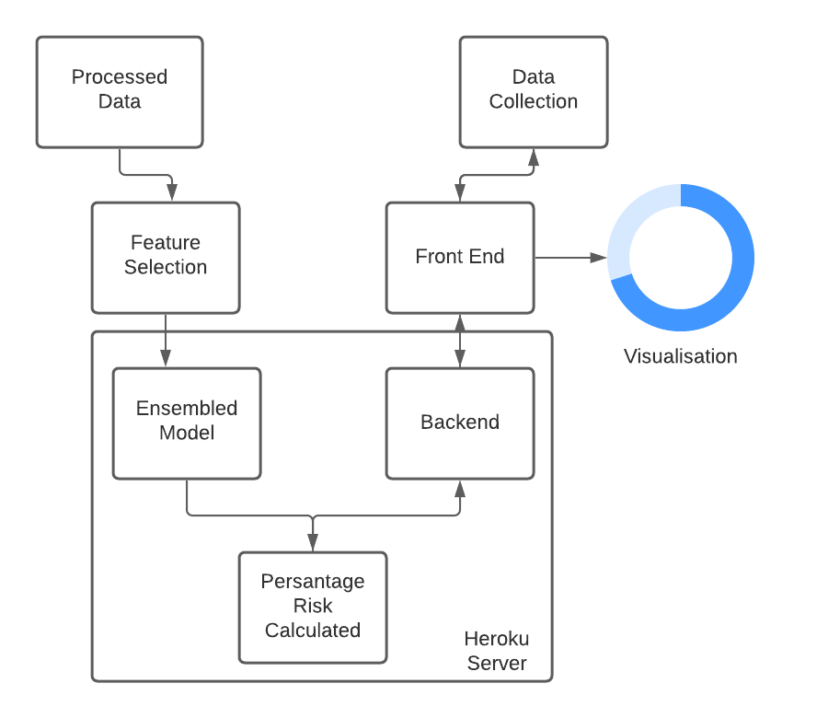
ARCHITECTURE

Slide 12
Advantages:
High performance and accuracy rate.
RCNN Classification is very flexible and is widely in various domains with high rates of success.

Slide 13
SYSTEM SPECIFICATION
Software Requirements:
Anaconda IDE
Python 3.7
Hardware Requirements:
Hard Disk: Greater than 500 GB
RAM: Greater than 4 GB
Processor: Core 2 Duo and Above

Slide 14
Clustering Module
We employ Fuzzy C means Clustering which is apt for clustering medical data.
The data given by the doctor and the patient has been Fed into then algorithm.
It is now the job of the clustering algorithm.
Data clustering is process of dividing data elements into classes or clusters so that items in the same class are as similar as possible, and items in different classes are as dissimilar as possible.

Slide 15
CLASSIFICATION MODULE
This is one of the simplest and fundamental methods of classification where the user does have a little knowledge or no understanding of the dissemination of the data.
The best score achieved of yolo between 1 and the given value is chosen that helps building parallel models on all values of k up to the extreme identified value for which y=9 was selected and scoring is done using the finest models from the available ones.

Slide 16
RCNN CLASSIFICATION
From the perspective of automatic learning, Medicine Overdose detection can be seen as a classification or clustering problem.
On the other hand, we formed a model on the vast set of presence and absence file data; we can reduce this problem to classification.
For known families, this problem can be reduced to one classification only - having a limited set of classes, including the Medicine Overdose sample, it is easier to identify the right class, and the result would be more accurate than with clustering algorithms.
In this section, the theoretical context is given on all the methods used in this research.

Slide 17
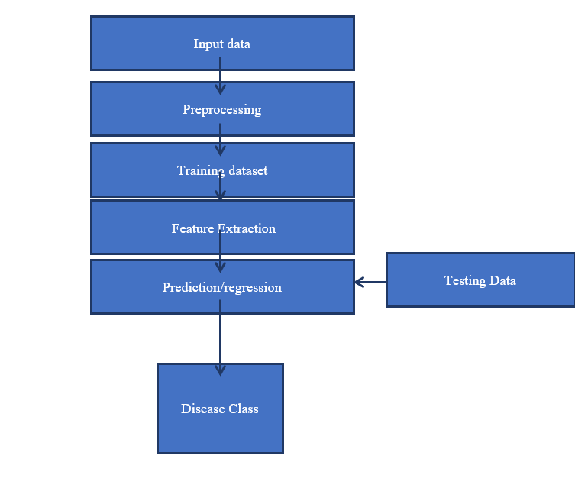
DATAFLOW DIAGRAM

Slide 18
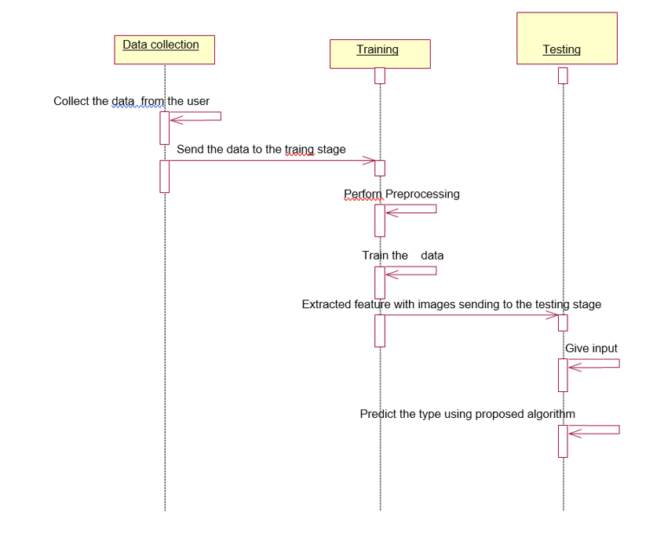
SEQUENCE DIAGRAM

Slide 19
APPLICATIONS
Clinical Diagnosis of medicinal Data
Medicinal Combination testing
Doctor Diagnosis Analysis

Slide 20
CONCLUSION
Medicine Overdose is still a widespread disease nowadays, and its diagnosis often requires frequent and very time-consuming clinical exams.
In this project, machine learning can provide effective tools to speed up the diagnosis process, by processing high-scale patients’ datasets in a few minutes.
we presented a computational system for the prediction of cervical patient diagnosis, and for the interpretation of its results.
Our deep learning methods predicted the diagnosis of the patients with high accuracy, and their application to other datasets showed that their robustness and effectiveness is not bounded to Medicine Overdose.

Slide 21
REFERENCES
[1] “The Atlas of Medicine Overdose and Stroke”, [online]. http://www.who.int/cardiovascular_diseases/res ources/atlas/en/
[2] J. S. Rumsfeld, K. E. Joynt, and T. M. Maddox, “Big data analytics to improve cardiovascular care: promise and challenges”, Nature Reviews Cardiology, Vol.13, No.6, pp.350, 2016.
[3] W. Dai, T. S. Brisimi, W. G. Adams, T. Mela, V. Saligrama, and I. C. Paschalidis, “Classification of hospitalization due to Medicine Overdoses by supervised learning methods”, International Journal of Medical Informatics, Vol.84, No.3, pp.189–197, 2015.
[4] I. Kamkar, M. Akbarzadeh-T and M. Yaghoobi, "Intelligent water drops a new optimization algorithm for solving the Vehicle Routing Problem", In: Proc. of IEEE International Conference on Systems, Man and Cybernetics, pp.4142-4146, 2010.
[5] N. M. Gazzaz, M. K. Yusoff, M. F. Ramli, H. Juahir, and A. Z. Aris, "Artificial neural network modeling of the water quality index using land use areas as predictors", Water Environment Research, Vol.87, No.2, pp.99- 112, 2015.

